Slide 1
Estimating Rates for Airbnb

Slide 2
Introduction
Our project aims at finding the Estimating the rental rates of Airbnb spaces based on location and facilities/services around the area. We refrained our study to Canada due to difficulty in finding relevant data.
People renting their spaces to Airbnb generally do not belong to the lodging. They see Airbnb as an additional source of income and not as a fulltime employment. They generally lack business understanding and face difficulty in estimating the rate they should offer for their space. This project will help them understand at what rate they can rent their space to benefit the customers and not suffer from losses either.
Our Project aims at providing these people an idea of what affects the real estate industry and accordingly estimate what would be the optimum rental they can offer

Slide 3
Packages installed for analysis
Urlopen from Library urllib
Beautiful soap from bs4
Pandas
Os
Requests
Json_normalize
Json
Numpy
Nominatim from geopy-geocoders
Foliun
Matplotlib.cm
Matplotlib.colors
Kmeans from sklearn.cluster

Slide 4
Data Description:
We limited:
Radius of each cluster- 100 meters
Variables in each cluster- 100
Number of clusters- 5

Slide 5
Methodology:
Getting the Zip Codes
Data Cleaning- removing empty values or appropriately assigning values to the missing spaces
Merging out data with data coordinates
Using the latitude and longitude values of Toronto, I define the center of the map. Then, I iterated through each row in the dataset and plot it on the map
Exploration

Slide 6
Cont….
Conducting Analysis- entire area was grouped in 38 neighborhoods and given values based on around 230 variables which would later help us in determining the rent rates of Airbnb rooms
Calculated top 5 common influencing venues for each areas
Performed Cluster analysis:

Slide 7
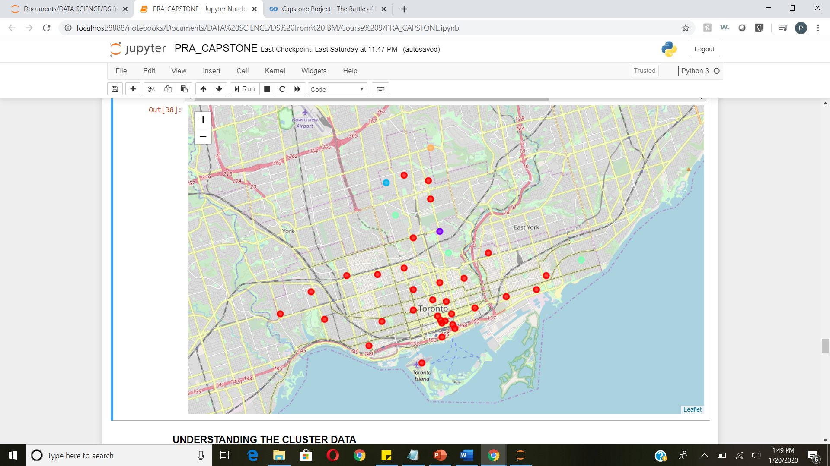
5 Cluster- Orange, Blue, Green, Red, Purple
Notice the rates downtown are much higher. It a common trend for rental spaces gets expensive as we move towards the main downtown due to availability and concentration of venues. The rates reduces as we move upwards

Slide 8
Results:
Following are the details of each cluster. The tables are self- explanatory. It includes:
Number of venues
Frequency of all the venues
Second tables for each cluster includes:
Location names
Cluster codes
List of most common venues in decreasing order of preferences.

Slide 9
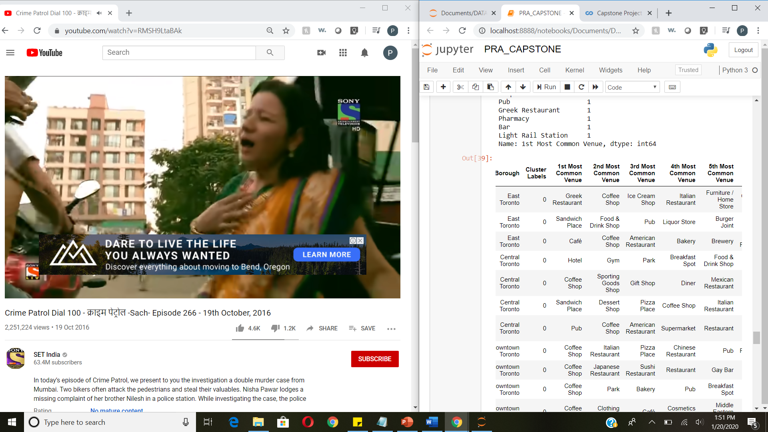
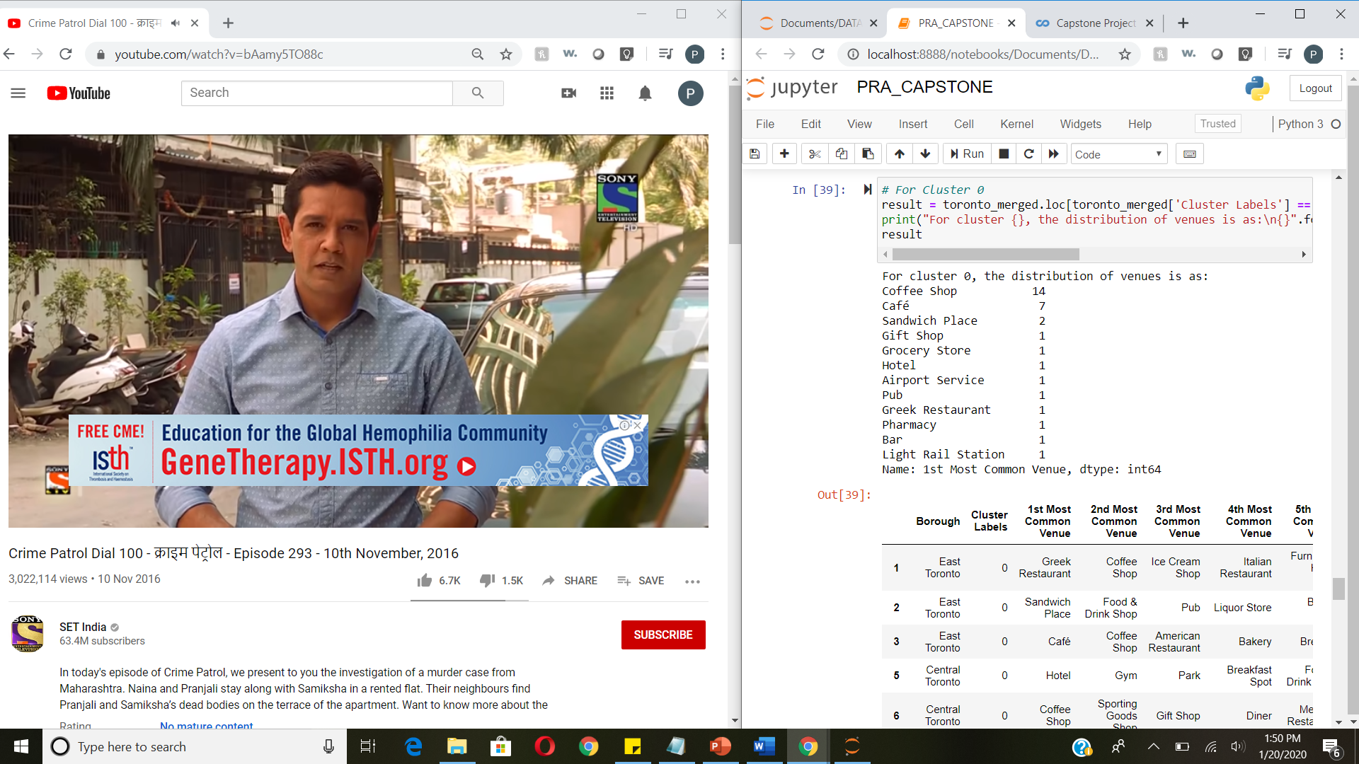
Cluster 1

Slide 10
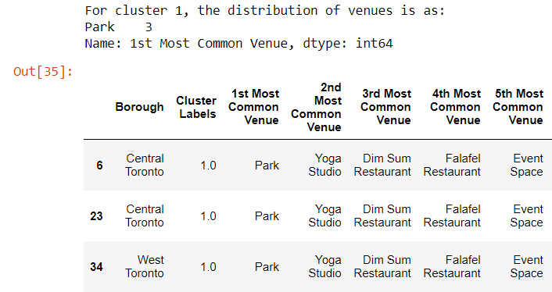
Cluster 2:

Slide 11
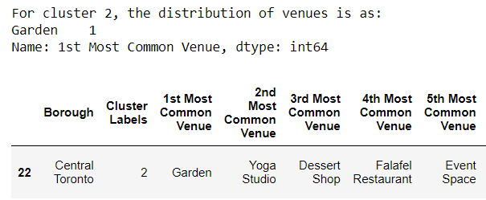
Cluster 3

Slide 12
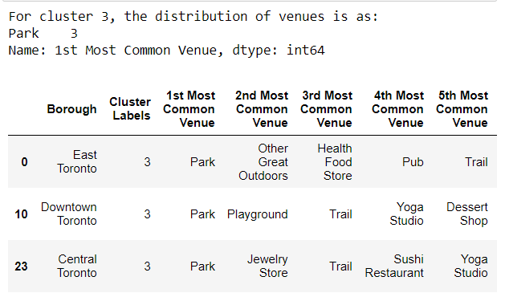
Cluster 4:

Slide 13
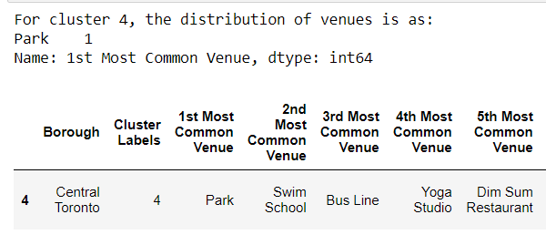
Cluster 5:

Slide 14
Discussion:
the rates downtown are much higher. It a common trend for rental spaces gets expensive as we move towards the main downtown due to availability and concentration of venues. The rates reduce as we move upwards
For data obtained through API calls, different results are returned with different set of parameters and different point of time. Multiple trial and error runs are required to get the optimal result.
Even after the dataset has been constructed, lots of research and analysis are required to decide if the data should be kept as is or be transform by normalization or standardization. It can be considered the most important process in the whole data science pipeline. Which can affect the most on the result.
On the other hand, choosing the suitable technique to construct the model is also a worthwhile process. As this report shows that, by applying a different method, the result can be improved.

Slide 15
Conclusion:
Doing this project helps practicing every topic in the specialization, and thus, equipping learners with Data Science methodology and tools using Python libraries. Also doing a real project certainly helps one learns so much more outside the curriculum, as well as realizes what more to research into after completing the program. And as this report shows, there are surely a lot of things to dig into.

